Slide 1
BIFX 503: Biostatistics in R
Instructor: Jennifer Schroeder, Ph.D.
Wednesdays, 5:30-8:15pm
Hodson Technology Center, Room 237
Fall 2021

Slide 2
Content
Review:
Generalized Linear Models
Logistic regression
Survival Analysis

Slide 3
Generalized Linear Models

Slide 4
What are Generalized Linear Models?
Generalization of linear regression techniques
Encompasses more than normally distributed dependent variables
Method extended to include binary and count data, among others
The dependent variable is predicted by a linear set of independent variables
The dependent variable is joined to the linear predictors by a link function

Slide 5
Components of Generalized Linear Models
Dependent variable (Y)
Distribution from the exponential family
Linear predictor (X’s)
independent variables
Link function
Relates the expected value of Y to the linear predictor

Slide 6
Techniques in the GLM
Simple Multivariate Form:
Multiple linear regression
ANOVA
ANCOVA
Logistic regression
Poisson regression
Survival analysis
Repeated measures
Full Multivariate Form:
MANOVA
MANCOVA
Factor analysis & PCA
Profile analysis
Discriminant function analysis
Bivariate Form:
Correlation
Simple linear regression
Text: Barbara Tabachnick & Linda Fidell’s Using Multivariate Statistics, 4th ed. Allyn & Bacon, 2001.

Slide 7
Forms of Regression
Type | Outcome Variable | Link Function | Measure of Association
Linear | Continuous | Identity | Change in Y per unit increase in X
Logistic | Binary | Logit | Relative odds of Y per unit increase in X
Poisson | Count | Log | Relative risk of Y per unit increase in X

Slide 8
Key Assumptions
Observations are independent and identically distributed (iid)
Data are cross-sectional, not longitudinal!
Methods have been developed to extend to correlated outcomes (GEE, GLMM)
Linear relationship between DV and IVs
Homoscedasticity (homogeneity of variance)
Standard deviations of the error term are constant and not dependent on the IVs

Slide 9
Independent Variables
IVs can be either continuous or discrete
Continuous IVs do not need to be normally distributed
Discrete IVs should be coded so that there is a reference category that the other levels are compared to
E.g. Drug=0 (placebo), =1 (tx1), =2 (tx2)
IVs can be correlated but not too highly

Slide 10
Model Fitting
Same procedure as for linear regression
Balance goodness-of-fit with complexity
Iterative in nature
Goal is an explanatory model with good fit to data
Examine model fit statistics at each step

Slide 11
Inference
Same as for linear regression
Parameter estimates (slopes)
Hypothesis tests: slope = zero?
Confidence intervals
Overall model fit
Different methods for assessing fit
Information Criterion, e.g., AIC, BIC

Slide 12
Logistic Regression

Slide 13
Logistic Regression
Answers the same questions as linear regression, only the outcome is binary instead of continuous
E.g. low birth weight yes or no
Instead of wanting to know the change in Y associated with X, you want to know the probability of Y associated with X
For example:
Is maternal smoking associated with the probability of low birth weight?

Slide 14
Logistic Regression
The logit function
logit(Y)=ln(Y/(1-Y))
Constrains the outcome probability 0<p<1
Allows the regression coefficients to have an odds ratio interpretation
e^{β1} = odds ratio for Y associated with a unit increase in X₁

Slide 15
Interpretation of Logistic Regression Coefficients
e^{β1} = odds ratio (OR) for Y associated with a unit increase in X₁
OR=2.0 means that a unit increase in X1 makes the outcome twice as likely
Positive association, positive sign on β₁
OR=0.5 means that a unit increase in X1 makes the outcome half as likely
Negative association, negative sign on β₁

Slide 16
Logistic Regression in R
glm(y ~ x, data, family=binomial(logit))
y = binary dependent variable (0/1)
x = independent variable
Can be continuous or categorical
family=binomial(logit)
Identifies link function

Slide 17
Logistic Regression in R
fit <- glm(y ~ x, data, family=binomial(logit))
Fits logistic regression model
Stores results as variable “fit”
summary(fit)
Prints summary
exp(coef(fit))
Prints exponentiated coefficients
exp(confint(fit))
Prints exponentiated confidence bounds

Slide 18
Blood Screening Example
Fibrinogen is associated with ESR > 20 while globulin is not
Association is statistically significant (p<0.05)
OR > 1, confidence interval excludes 1
Adding globulin to the model does not improve fit
How do these proteins do at classifying patients as ESR > 20?

Slide 19
ROC Curves
A receiver operating characteristic (ROC) curve is a graphic that illustrates the diagnostic ability of a binary classifier
The area under the curve (AUC) is a measure of how well the classifier performs
Over 0.90 is Excellent
0.80-0.90 is Good
0.70-0.80 is Fair

Slide 20
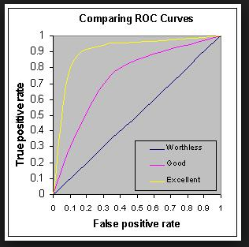

Slide 21
Blood Screening Example
Fibrinogen
Fibrinogen + Globulin
AUC = 0.71
AUC = 0.81

Slide 22
Survival Analysis

Slide 23
What is Survival Analysis?
Predicting the amount of time it takes for a specified outcome to occur
a.k.a. time-to-event
The outcome can be:
Mortality (hence the name survival analysis)
Study dropout
Occurrence of medication side-effect
Relapse to disease condition

Slide 24
Person-Time Data
Survival analysis and incidence-rate analysis utilize person-time data
Person-time data requires specialized methods for analysis developed for rates and proportions
Numerator: number of cases (events)
Denominator: time frame during which these events were observed

Slide 25
Censored Data
What makes survival analysis unique is that a proportion of the outcomes are likely censored
You don’t know the exact value of the survival time, but you know it exceeds a certain value
This is known as right censoring. Other forms of censoring exist (e.g. interval censoring) but right censoring is the focus of this class.
Examples:
Study retention time – Completers are censored: when would they have dropped out if the study had been infinitely long?
Time until relapse – Dropouts are censored: when would they have relapsed if they had stayed in the study? (Those who completed the study and remained healthy until the end are also censored.)
Survival analysis maximizes use of the available data by incorporating censored as well as non-censored observations

Slide 26
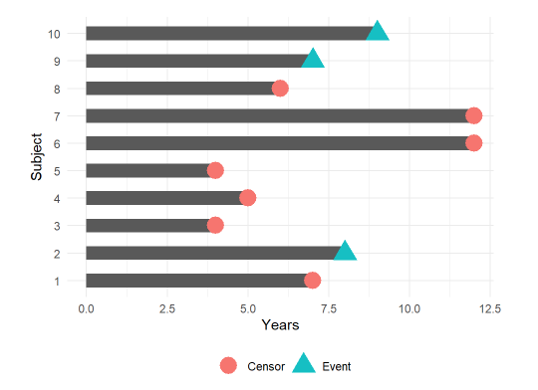
Censored Survival Data
Subjects 2, 9, and 10 experienced the event during their time in the study, so their event time is known.
The other subjects did not because they dropped out of the study (1, 3, 4, 5, 8), or the study ended (6 & 7) before they experienced the event. Their event time is not known, but it is known to exceed the last time they were observed in the study.
Image credit: https://www.emilyzabor.com/tutorials/survival_analysis_in_r_tutorial.html

Slide 27
Survival Analysis: Objectives
In its simplest form, you just want to know if the survival time in one group differs from another
E.g., are study groups equivalent with respect to participant relapse rates?
Life table methods: Log-rank and Wilcoxon tests
In more complex analyses, you want to know if survival time is influenced by other factors (covariates)
E.g., how do demographics influence relapse rates?
Regression methods: Cox Proportional Hazards Model

Slide 28
Survival Analysis in R
Package survival
Surv(time, status)
time is the time variable
status is the censoring variable
creates a survival object that is the dependent variable for use in functions that perform survival analyses
Survfit(Surv(time, status) ~ 1)
Creates survival curves

Slide 29
Kaplan-Meier Plot
A Kaplan-Meier plot enables visualization of the survival curve for a group, or comparison of survival curves for subgroups
X axis is time
Y axis is survival probability
Default curve is step function with 95% confidence interval
plot(survfit(Surv(time, status) ~ 1, data=lung))

Slide 30
Median Survival Time
Median survival time is the time at which the survival probability is 50%
To estimate median survival time
survfit(Surv(time, status) ~ 1, data=lung)
Median = 310 days, 95% CI (285, 363)

Slide 31
Comparing Survival Curves
Often you want to compare the survival experience of two groups, e.g., treatment arms in a clinical trial
First, visualize the data using Kaplan-Meier plot to show group differences
plot(survfit(Surv(time, status) ~ group, data)
Calculate median survival time separately for each group
survfit(Surv(time, status) ~ group, data)
Formally test for group differences using log rank test
logrank_test(Surv(time, status) ~ group, data)

Slide 32
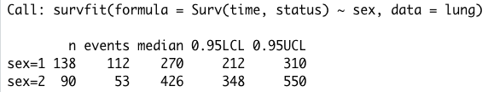
Kaplan-Meier Plot to Compare Groups
plot(survfit(Surv(time, status) ~ sex, data=lung, lty=c(1,2))
survfit(Surv(time, status) ~ sex, data=lung)
Male=1
Female=2
Females have longer survival time

Slide 33
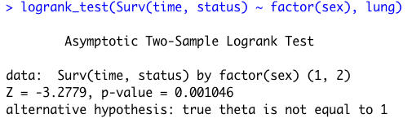
Log Rank Test to Compare Groups
logrank_test(Surv(time, status) ~ factor(sex), lung)
Result: survival differs by sex (p < 0.05)

Slide 34
Regression Models for Survival Analysis
Survival function:
S(T) = survival to end of time interval
Hazard function (a.k.a. instantaneous failure rate)
λ(T) = probability of failure in the next (infinitely short) time interval, given survival until time T
Regression equation:

Slide 35
Regression Models for Survival Analysis
Most commonly used is the Cox Proportional Hazards Model (Cox Regression)
“Proportional hazards” implies a key assumption: that the hazard associated with one group is proportional to that for the other group throughout the follow-up period
Plot of survival curves should show parallel lines (at least they should not cross)
The effect of the covariates should not vary with time

Slide 36
Regression Models for Survival Analysis
Other important assumptions:
“Censored” participants are not systematically different from those not censored
Survival conditions are uniform throughout the study period (i.e. things that affect survival at the beginning of the study also affect it at the end)
Covariates are not too highly correlated
Further assumptions (normality, linearity, homoscedasticity) are not required but enhance power and the predictive ability of the model
Note: Cox regression does not rely on an explicit distributional assumption for the DV and thus is considered “semi-parametric”. However there are other parametric regression methods for survival analysis (e.g. accelerated failure-time models).

Slide 37
Regression Models for Survival Analysis
Like logistic regression:
Coefficients have Risk Ratio interpretation
i.e. reflect risk of event happening associated with the covariate
Hazard Ratio (HR) instead of Odds Ratio (OR)
IVs can be either continuous or dichotomous
Dummy variable coding for categorical IVs
Model can include interaction terms
Same model-building strategies exist

Slide 38
Interpretation of Cox Regression Coefficients
e^{β1} = hazard ratio (HR) for Y associated with a unit increase in T₁
HR=2.0 means that a unit increase in T1 makes the event twice as likely
Positive association, positive sign on β₁
HR=0.5 means that a unit increase in T1 makes the event half as likely
Negative association, negative sign on β₁

Slide 39
Cox Regression Functions in R
Package survival
Surv(time, event) ~ group
Formula notation where time is the survival time, and event is the censoring variable (survival yes or no)
coxph(survfit(Surv(time, event) ~ group, data)
Fits Cox proportional hazards model to test the effect of group on survival

Slide 40
Cox Regression Model Fit
Overall assessment of model fit is shown below the regression coefficients: likelihood ratio test, Wald test, score test
Each tests the null hypothesis that all of the coefficients are zero
Statistical significance indicates good model fit
Use of residuals not as easy as for linear regression (see text)
cox.zph() function to test if effects of covariate is constant over time

Slide 41
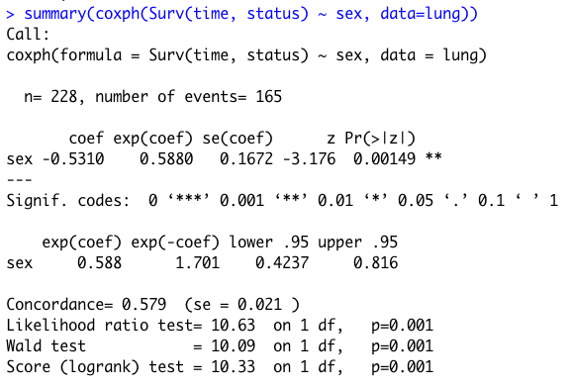
Cox Regression Results
coxph(Surv(time, status) ~ sex, data=lung)
Hazard Ratio (HR) associated with being Female is 0.59
The model fits the data well – LRT, Wald, score tests all significant

Slide 42
Tree-Based Methods for Survival Data
Tree based regression models can be applied to censored survival data
Both recursive partitioning and conditional inference trees can be used
Conditional inference tree method uses log rank test to choose optimal cut points
Result: prognostic model (predictors of survival)

Slide 43
Conditional Inference Tree for Lung Cancer Data
lung_ctree <- ctree(Surv(time, status) ~ ., data = lung)
Most important variable: ECOG
≤1 ambulatory
>1 in bed at least half of day
Second most important: Sex
1=male
2=female
Ambulatory and female: longer survival

Slide 44
Glioma Treatment Example
glioma data from coin package
Novel radioimmunotherapy for glioma patients
Do patients receiving the novel therapy live longer than those who don’t?
Variables include patient age, sex, histology, treatment group, survival event, survival time

Slide 45
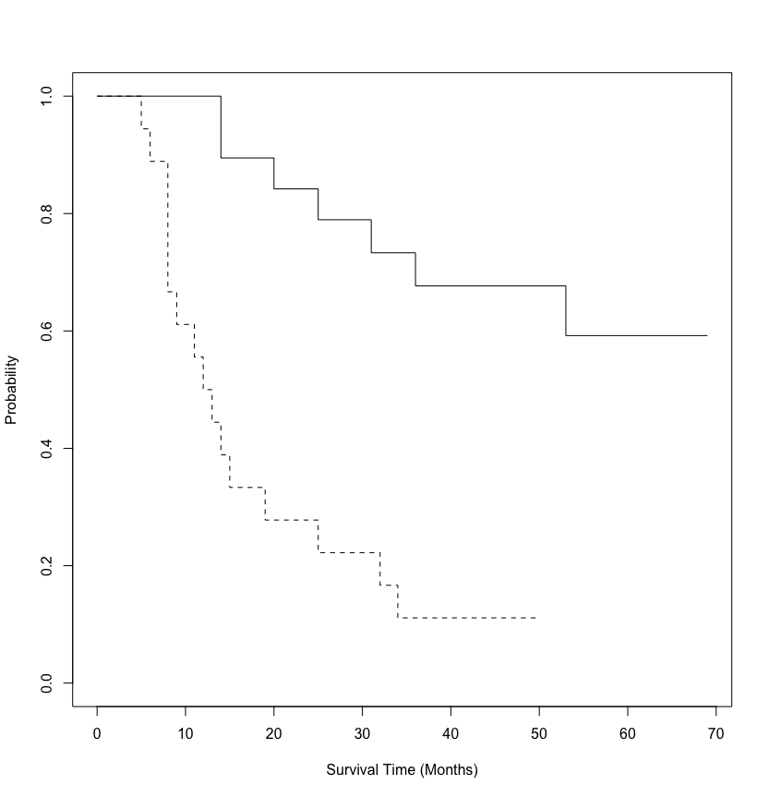
Glioma Treatment Example
plot(survfit(Surv(time, event) ~ group, data=glioma), ylab="Probability", xlab="Survival Time (Months)", lty=c(2,1))

Slide 46
Glioma Treatment Example
Interpretation of regression slopes
A positive sign means that the hazard (risk of death) is higher
A negative sign means that the risk of death is lower, survival is greater
To calculate the risk of survival, put a negative sign on the coefficient for failure, and exponentiate that to get RR for survival
The RIT group has a significantly lower hazard (greater survival)
After adjusting for demographics and histology this gets stronger

Slide 47
Glioma Treatment Example
Model | Regression Coefficients ± SE | HR of failure HR of survival
RIT | -1.83 ± 0.49 (0.00019) | 0.16 6.23
RIT plus covariates (age, sex, histology) | -2.44 ± 0.58 (<0.0001) | 0.087 11.5
RIT Group:
Failure is less likely (negative sign on regression coefficient)
Risk of failure is exponentiated coefficient, e^{1.83} = 0.16
Survival is more likely
Risk of survival is exponentiated negative coefficient, e^{-1.83} = 6.23
Association becomes stronger (almost doubles) when covariates are included in the model
Indicators of model fit show (slightly) improved fit when covariates added

Slide 48
Difference by Tumor Type
Grade III
Grade IV

Slide 49
Stratified Cox Regression
Does treatment extend survival for both groups of tumors?
Stratified Cox regression to test this hypothesis for both groups simultaneously
Approximate log rank test used
Result: treatment impacts survival for both
Z=3.67, p<0.0001
logrank_test(Surv(time, event) ~ group | histology, data=glioma, distribution = approximate(B = 10000))

